Slide 1
IMDB Movie Analysis
BY – Ayush WAnkhede

Slide 2
Project Description
This project's objective is to analyze a collection of IMBD movies and draw conclusions from the information. columns in the dataset such as movie name, budget, gross income, and IMDB ratings are just a few examples. You will need to use a variety of Excel formulas and SQL commands to clean and manipulate the data in order to finish the project. You will be required to complete particular tasks, such as determining the most profitable film or the best-performing IDMB films, and to share your own insights by spotting any issues or patterns in the data. Additionally, you might be requested to present your findings using charts and visualizations. The overall objective of the project is to gain a better understanding of the movies industry by analyzing the data and drawing meaningful conclusions.

Slide 3
Approach
SQL and Excel was employed to carry out the job. With the provided raw data, a database was created using SQL queries and Excel functions . Many sorting and data extraction queries and functions were used after the database was constructed to obtain the necessary data and insights.
Understand the Data
Check for missing or incomplete data
Identify and handle outliers
Communicate your findings

Slide 4
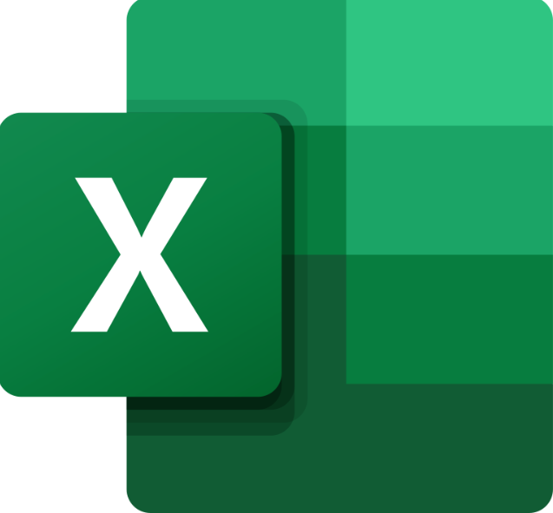



Tech-Stack Used
Excel
PowerPoint
SQL
Google drive

Slide 5
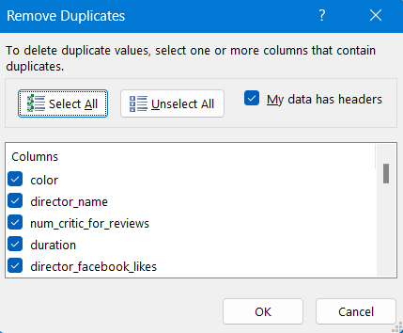
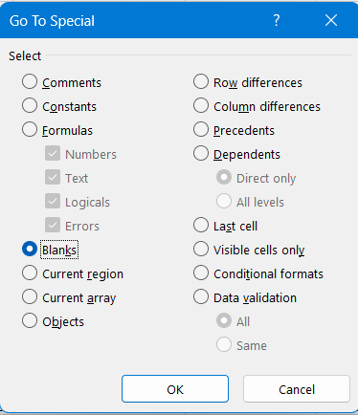
Cleaning the data: This is one of the most important step to perform before moving forward with the analysis. Use your knowledge learned till now to do this. (Dropping columns, removing null values, etc.) Your task: Clean the data
Insights
I adjusted the column width so that better reliability and correctly formatted of the columns so that to get the clean data. By choosing the "FIND $ SELECT" option and eliminate the entire row containing duplicates and null data. Hence, the data was more accurate and prepared for analysis.
Before cleaning : 5044 Rows + null values + duplicates
After cleaning: 3724 Rows

Slide 6
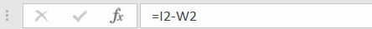
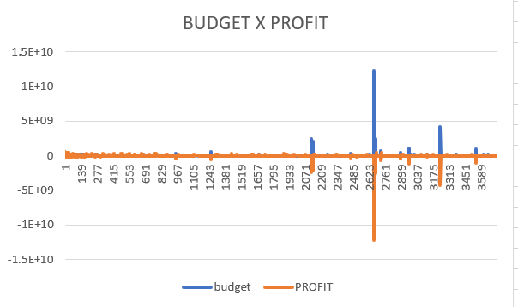
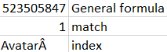
B. Movies with highest profit: Create a new column called profit which contains the difference of the two columns: gross and budget. Sort the column using the profit column as reference. Plot profit (y-axis) vs budget (x- axis) and observe the outliers using the appropriate chart type. Your task: Find the movies with the highest profit?
Step 1- New column of profit is created which contains the difference of the gross and budget.
Step 2 - Plot a graph of Profit X budget using charts function .
Step 3 - To find the movie with the Highest Profit we use
Match() and Index() function . Our Match() function finds the
highest value from Profit column and its position also.
Index function is used to print value at that particular index.
Finally we will combine these two ideas of index and match to
find our general formula
=INDEX(AC2:AD3724,MATCH(MAX(AC2:AC3724),AC2:AC3724,0),1)
=MATCH(MAX(AC2:AC3724),AC2:AC3724,0)
=INDEX(AD2:AD3724,1,0)
Avatar is the movie with the highest profit.

Slide 7
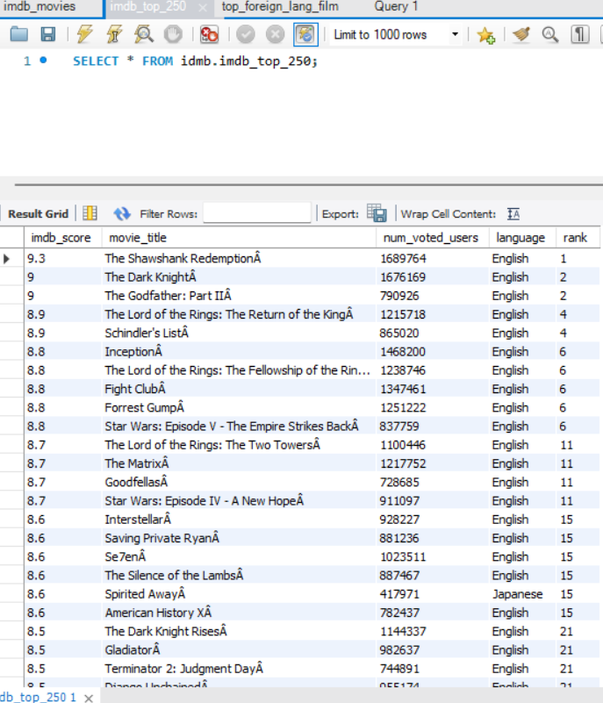
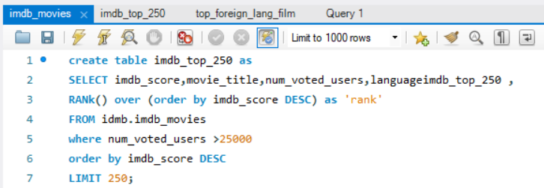
C. Top 250: Create a new column IMDb_Top_250 and store the top 250 movies with the highest IMDb Rating (corresponding to the column: imdb_score). Also make sure that for all of these movies, the num_voted_users is greater than 25,000. Also add a Rank column containing the values 1 to 250 indicating the ranks of the corresponding films. Extract all the movies in the IMDb_Top_250 column which are not in the English language and store them in a new column named Top_Foreign_Lang_Film. You can use your own imagination also! Your task: Find IMDB Top 250
Here I used SQL Query to identify the top 250 movies with the Highest IMDB scores and a minimum of 25000 votes user and Rank them on base of there IMDB score. Here is the list ->
..250

Slide 8
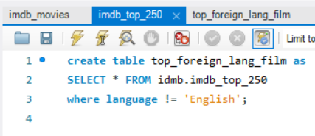
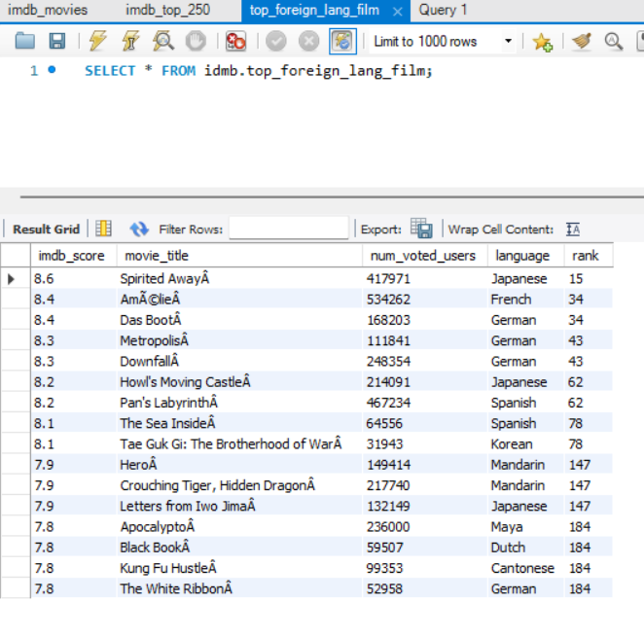
I used SQL Query to create a table of top foreign language films from the table of top 250 IMDB movies .
The films in this table are those whose language is not English.
Here is the list->

Slide 9
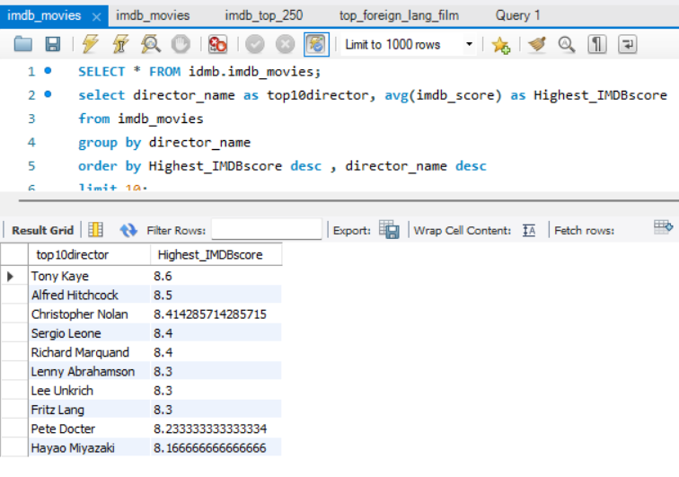
D. Best Directors: Group the column using the director_name column. Find out the top 10 directors for whom the mean of imdb_score is the highest and store them in a new column top10director. In case of a tie in IMDb score between two directors, sort them alphabetically. Your task: Find the best directors
Here I used SQL Query to find the best directors on the based of there average/mean imdb_score and if the mean imdb _score is same then sort them on the based on directors_name alphabetically.
From the data provide and after applying SQL query we can say that “TONY KAYE” is the best director

Slide 10
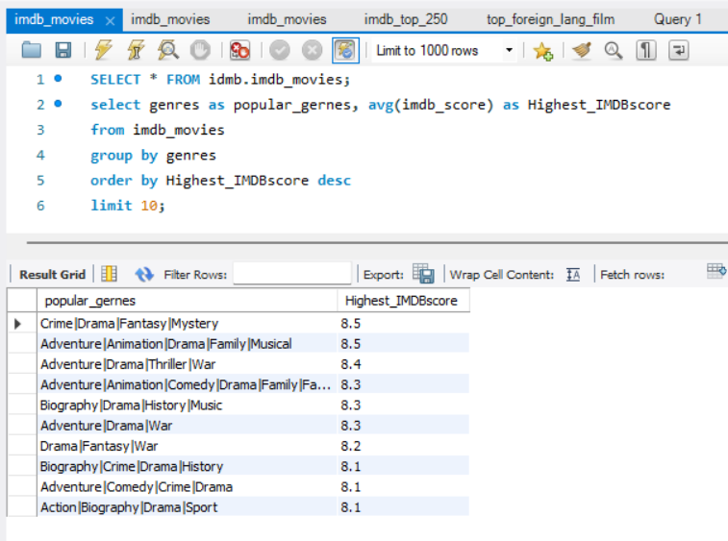
E. Popular Genres: Perform this step using the knowledge gained while performing previous steps. Your task: Find popular genres
From the data provide and after applying SQL query we can see that “Crime|Drama|Fantasy|Mystery” genres has the highest average/ mean imdb score , indicating that it is most popular genres

Slide 11
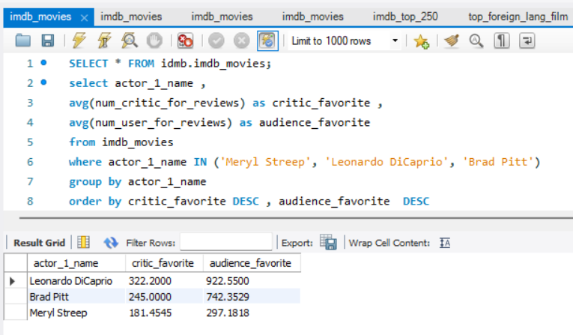
F. Charts: Create three new columns namely, Meryl_Streep, Leo_Caprio, and Brad_Pitt which contain the movies in which the actors: 'Meryl Streep', 'Leonardo DiCaprio', and 'Brad Pitt' are the lead actors. Use only the actor_1_name column for extraction. Also, make sure that you use the names 'Meryl Streep', 'Leonardo DiCaprio', and 'Brad Pitt' for the said extraction. Append the rows of all these columns and store them in a new column named Combined. Group the combined column using the actor_1_name column. Find the mean of the num_critic_for_reviews and num_users_for_review and identify the actors which have the highest mean.
Here based on the data provided “'Leonardo DiCaprio” is the audience favorite and critic favorite actor among 'Meryl Streep', 'Leonardo DiCaprio', and 'Brad Pitt’.

Slide 12
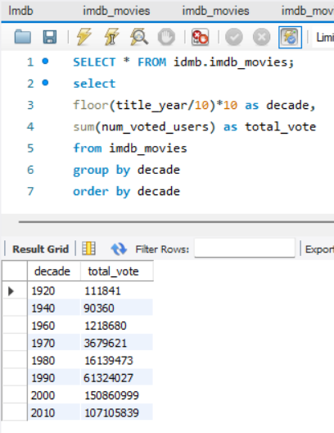
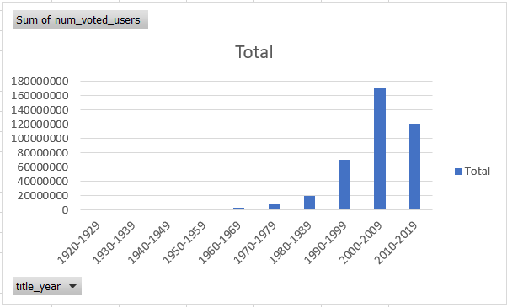
Observe the change in number of voted users over decades using a bar chart. Create a column called decade which represents the decade to which every movie belongs to. For example, the title_year year 1923, 1925 should be stored as 1920s. Sort the column based on the column decade, group it by decade and find the sum of users voted in each decade. Store this in a new data frame called df_by_decade.
From the data we can Observe that during 2000 ,there is highest number of user who voted for movie

Slide 13
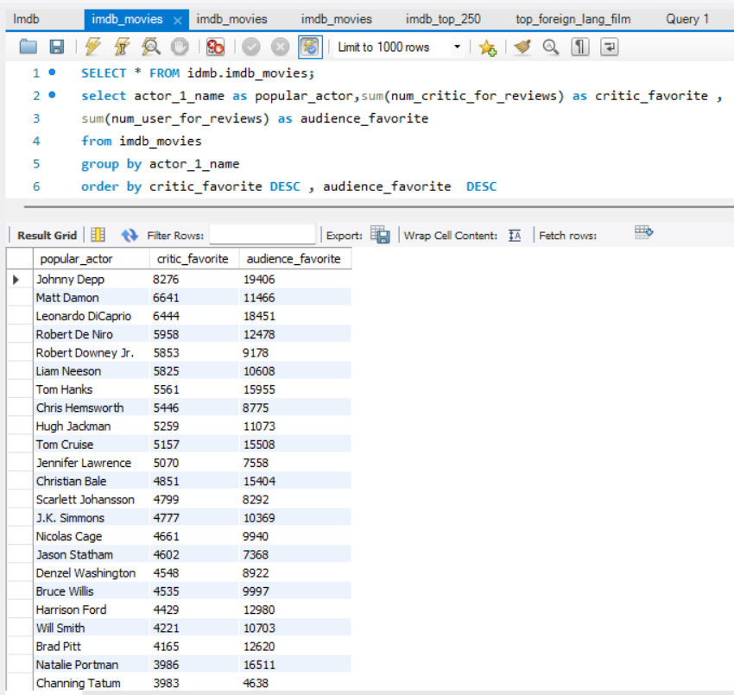
Your task: Find the critic-favorite and audience-favorite actors
Johnny Depp is highly popular actors among critic and audience favorite actor.

Slide 14
RESULT
I learned during this assignment that a variety of factors affect a movie's success. I also learn how to use tools like SQL and Excel to analyze and comprehend data.by combining these tools. I developed a more thorough understanding of what contributes to a successful movie. This study has made it clear to me how important it is to take into account a variety of factors and points of view when analyzing data.
By completing this assignment, I was able to develop my query-writing and query-execution abilities and gain an understanding of the duties and obligations of a data analyst in a professional setting.

